Slide 1

A Journey towards possibilities
Warrior Genies

Slide 2
When you have exhausted all possibilities, remember this you haven’t – Thomas Edison
AGENDA
Introduction
Product Overview
Roadmap / Plan
Final Thoughts
Q & A

Slide 3

Our team
Sadaf
Gulfam
Anam
Umar
Saurav

Slide 4
Our believes
Put user at the heart of the solution
04
Provide solution that technology platform agnostic
03
Use Open source technology to keep costs low
02
Iteratively build experiences and features
01

Slide 5
Goals of our journey
Information on your Finger tips
Stay on top of things
Share it anytime - anywhere
Reduce efforts to manage data
Monitor my health

Slide 6

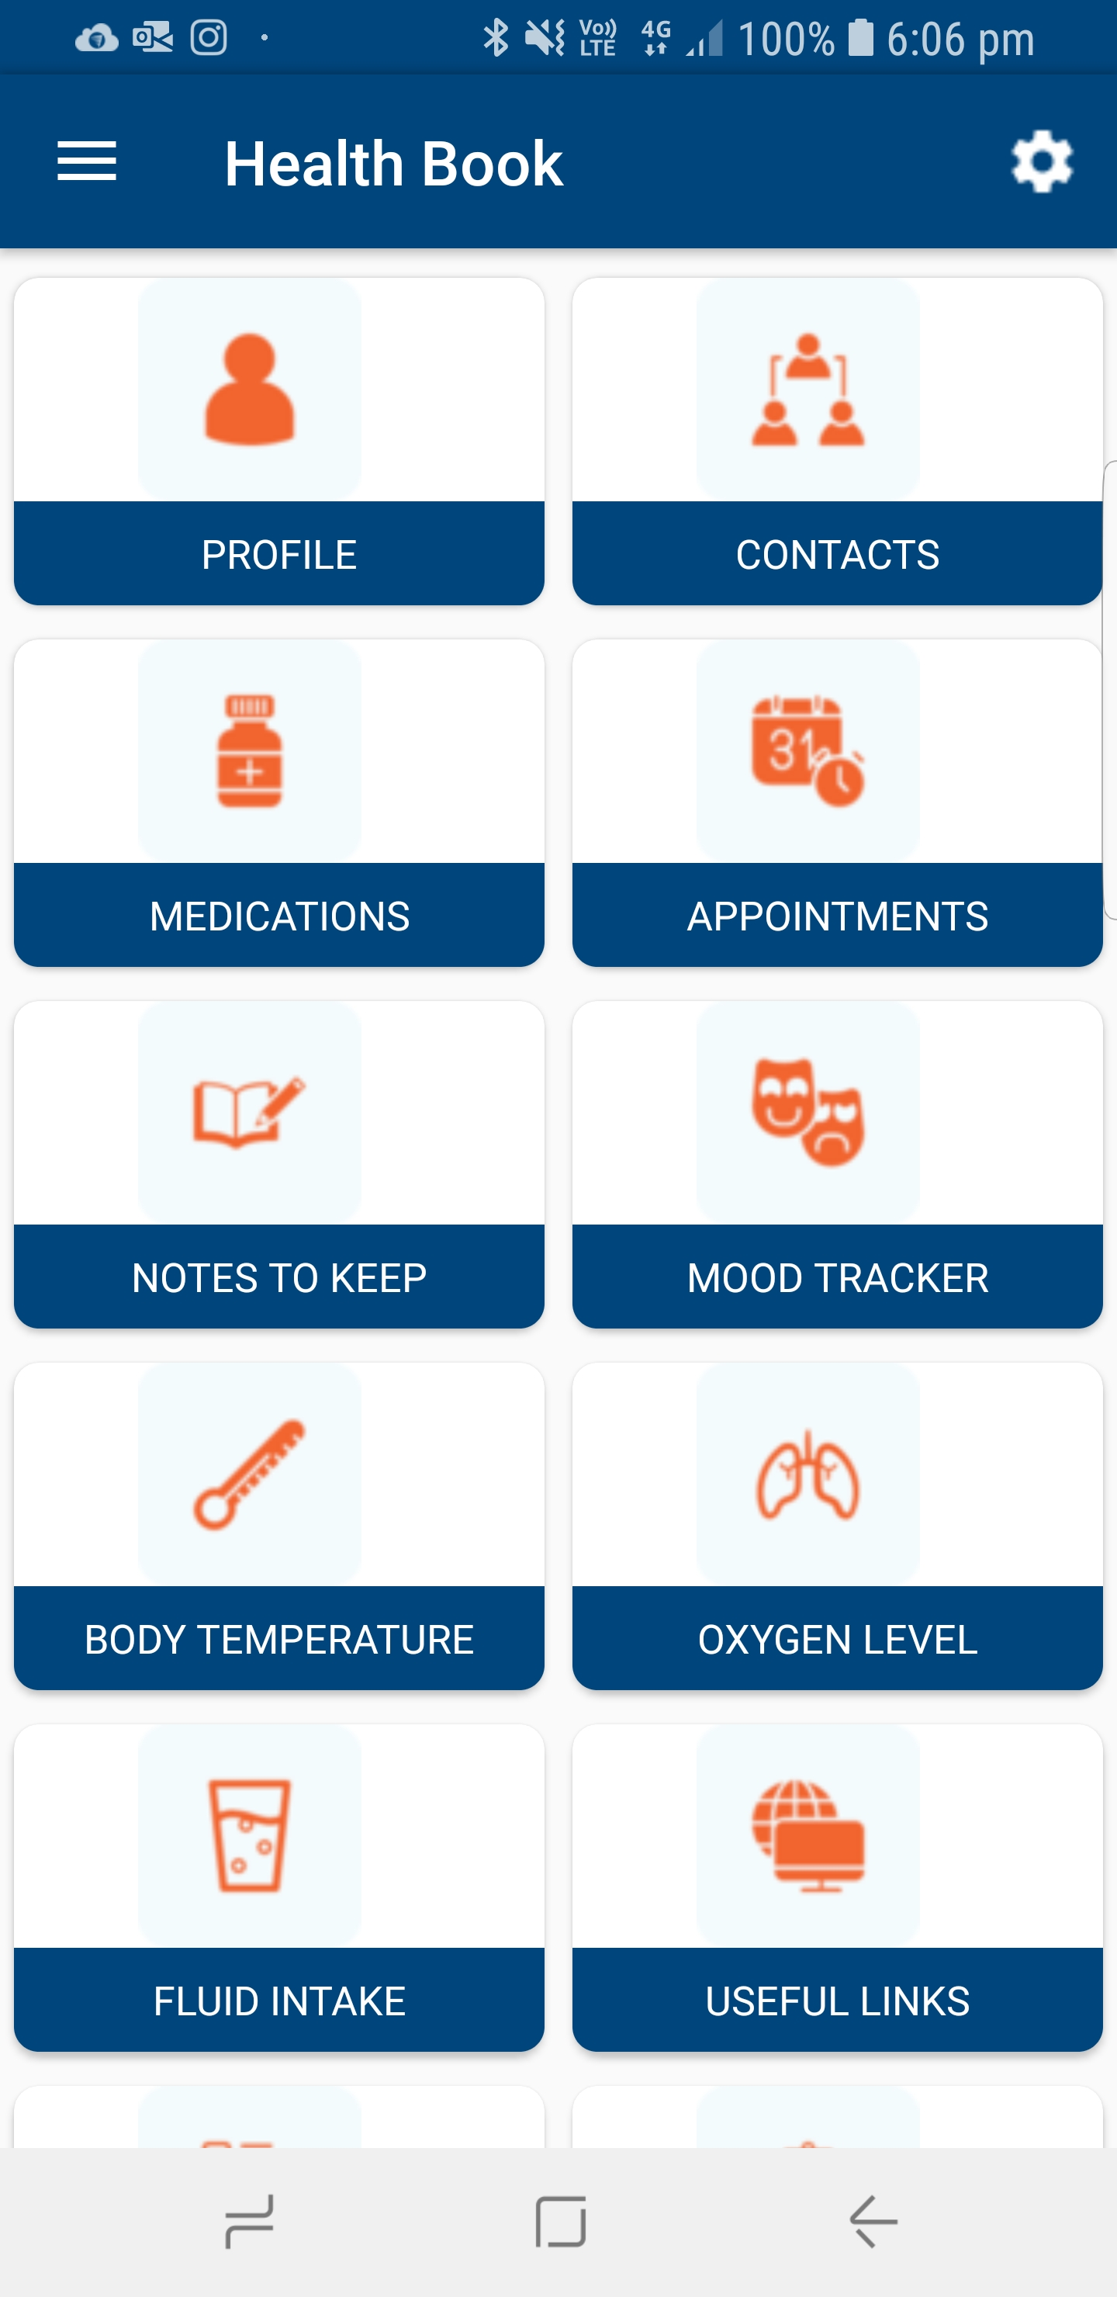
Our Product Health Book app
All medical information on your Phone/Tablet
Facilitates well managed appointments via handy essential information:
Personal and health related
Checklists and Questions
Reports, Health Statistics
Prompts people to recall appointments & medication through generating reminders

Slide 7
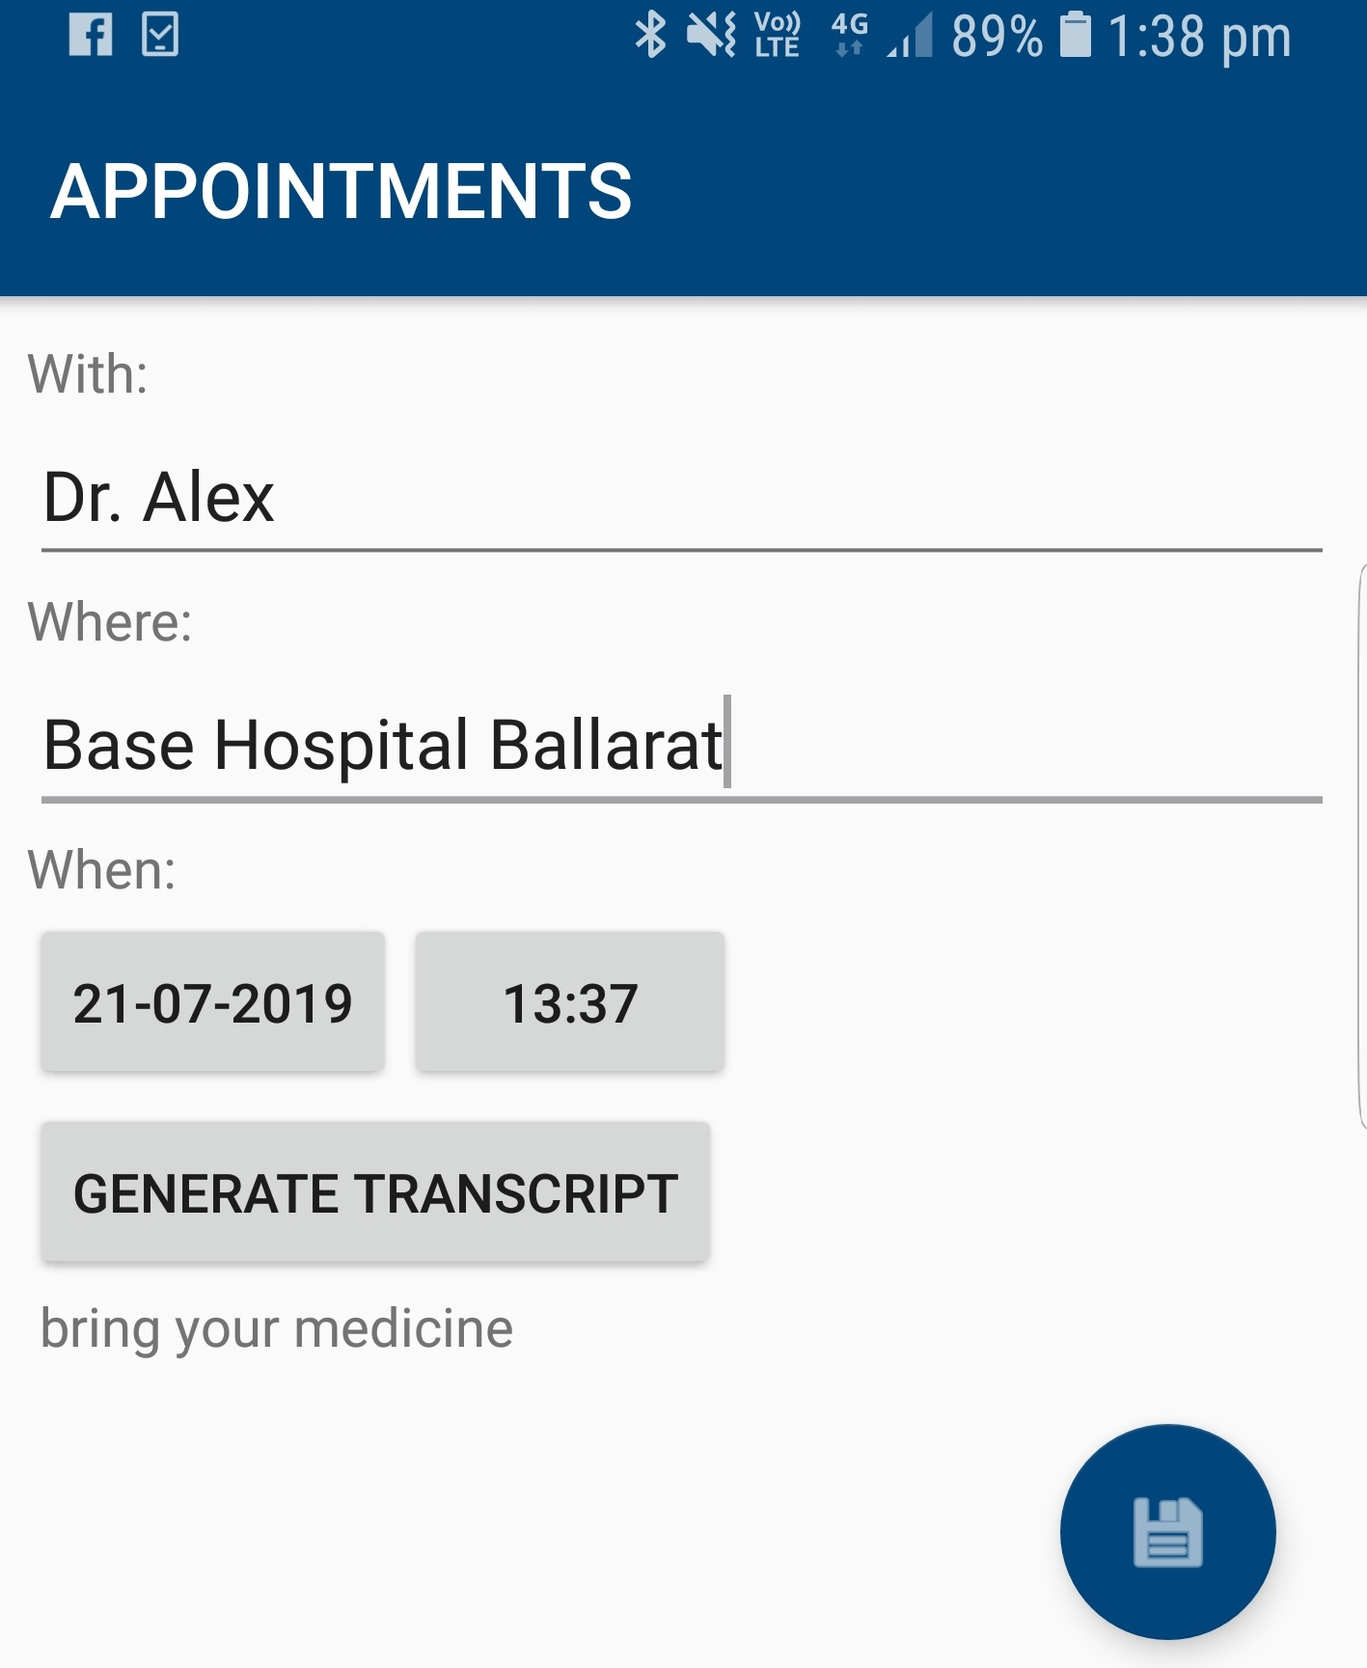
A Step further …
Voice Notes & transcription

Slide 8
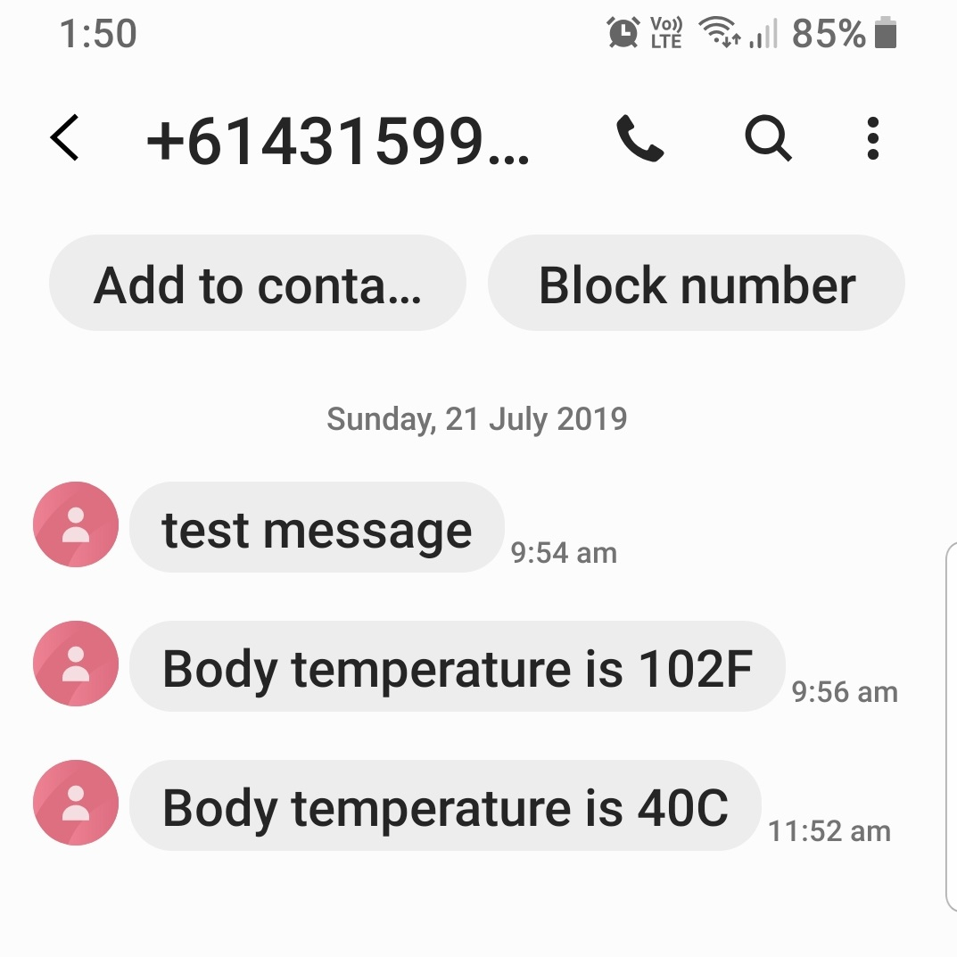
And more…
Notification on detecting abnormality

Slide 9
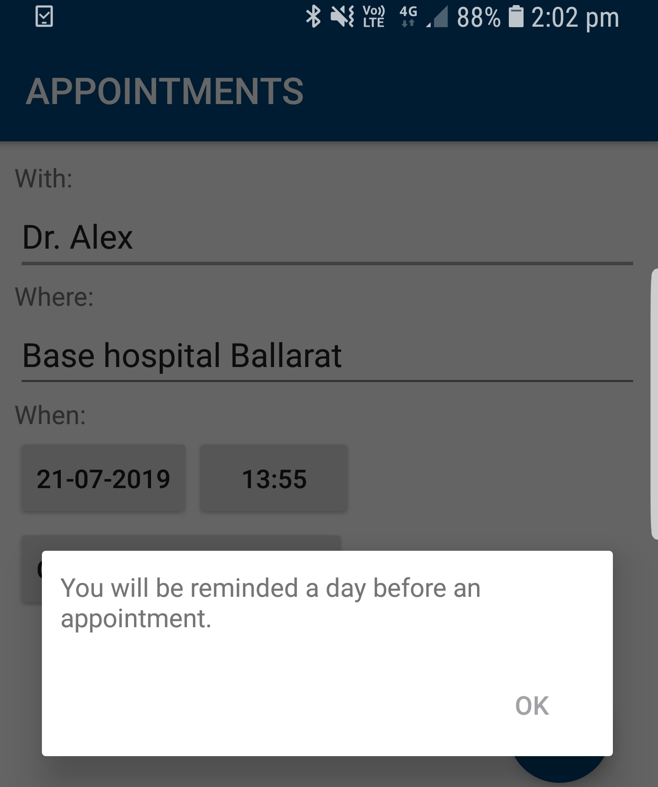
And Further…
Appointment & Medication Reminders

Slide 10
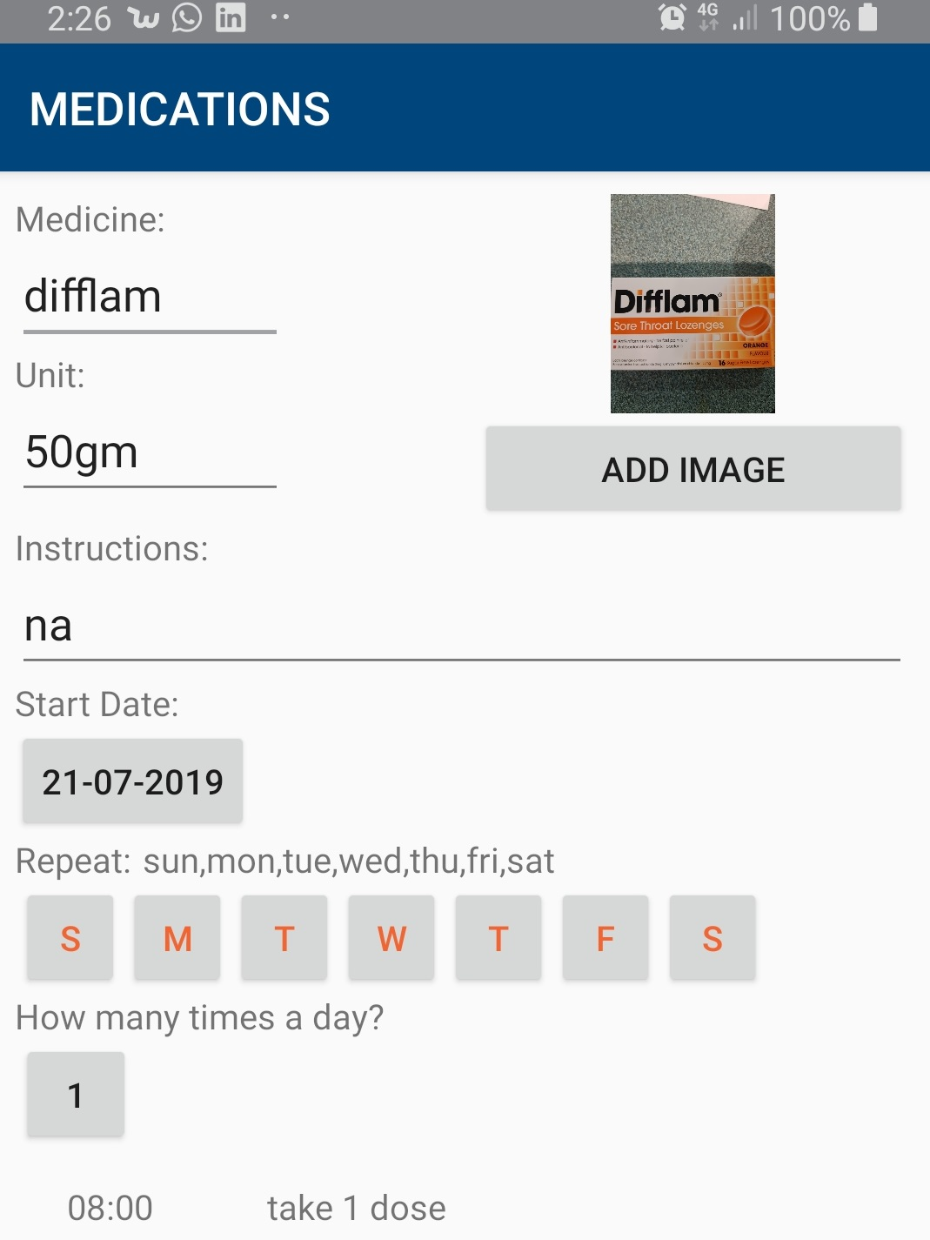
And...
Capture picture of Medicine using Camera

Slide 11
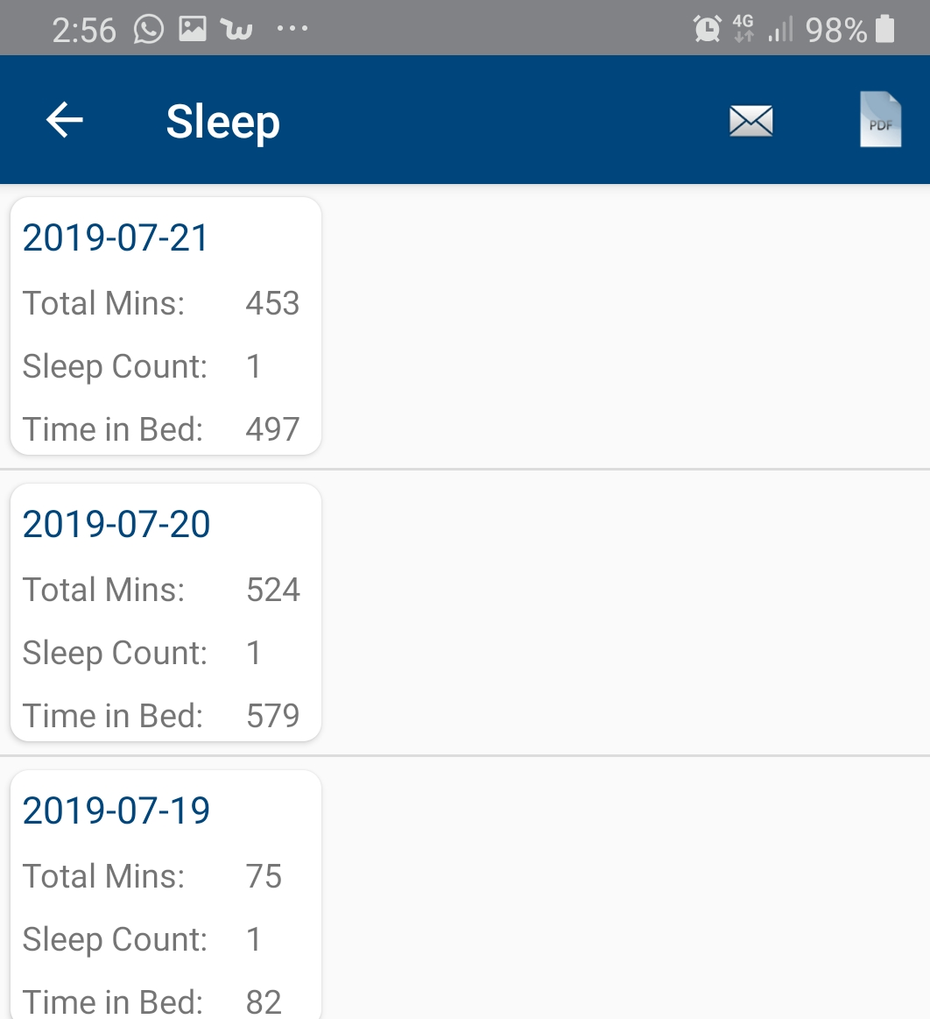
And way beyond...
Sync Health information from you wearable/device – Fitbit in this case!!

Slide 12
And some prototypes…

Slide 13
RoadMap / Plan
Connecting more wearables /devices
Voice to text (End to End)
Wellbeing Tracking & Notifs
Carer / Patient data sharing
App on Apple Devices
Image Recognition/OCR
Side Effects & Medicine/Therapy Tracking
Beta version Launch
Sentiment Tracking
Months
1
3
6
12
Proposed Team Structure (8 – 10 members)
4 Developers (2 Android / 2 iOS)
1 AI/Machine Learning Engineer
3 Testing Professionals
1 UX Designer
Solution Cost Breakdown over 12 months
Development
Operational
User
Beta version will include everything that My Cancer Care Record Folder should store.
Notes:
Enable user to take and store pictures
Read Textual data to record events
Reports to include Image data
Use Image data for proactive health monitoring

Slide 14
Final Thoughts
HealthBook App is just a beginning to enormous possibilities
Useful to any Chronic Illness management
Secure and Safe way to store and share data
Extendable and Scalable solution
Built using Open source/freely available technology to keep it cost effective in terms operational expenses
Solution is Vendor and Technology Agnostic
Various Business models can be explored –
Cost Recovery – via Charitable or Government Funding
Subscription
Life-time subscription
Notes:
Enable user to take and store pictures
Read Textual data to record events
Reports to include Image data
Use Image data for proactive health monitoring

Slide 15
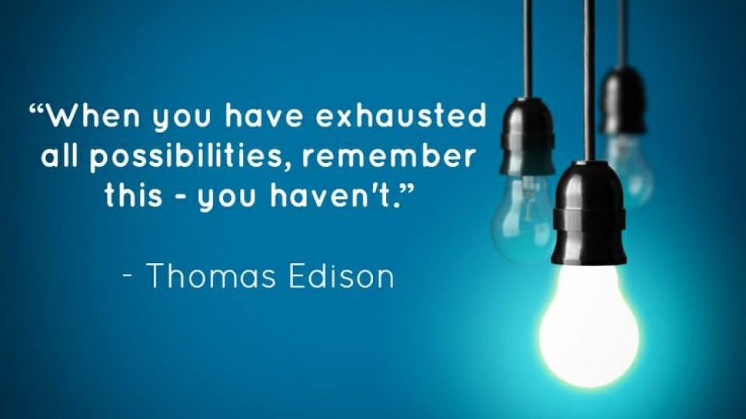
Q & A
Notes:
Enable user to take and store pictures
Read Textual data to record events
Reports to include Image data
Use Image data for proactive health monitoring

